Slide 1
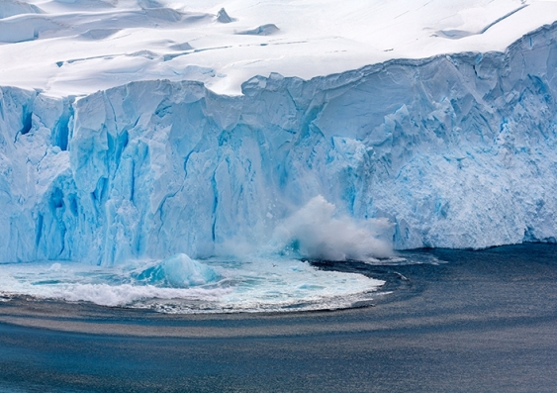
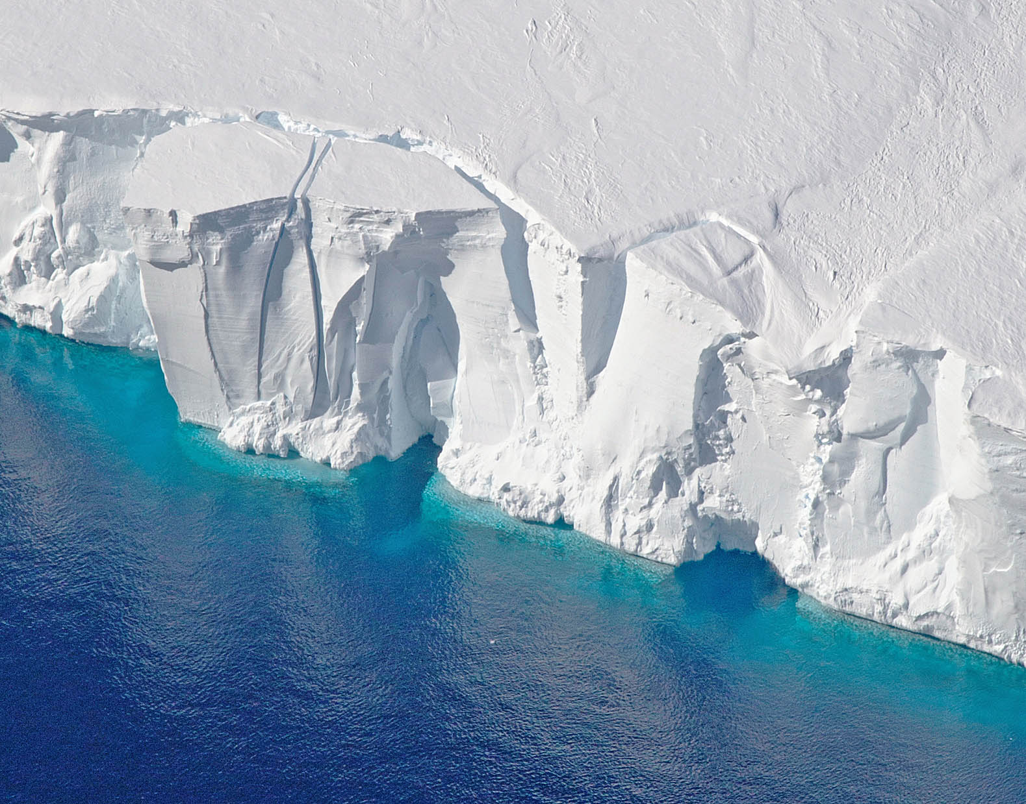
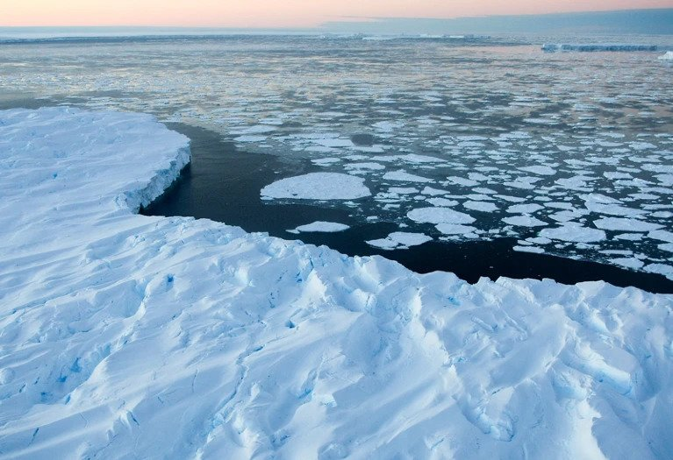
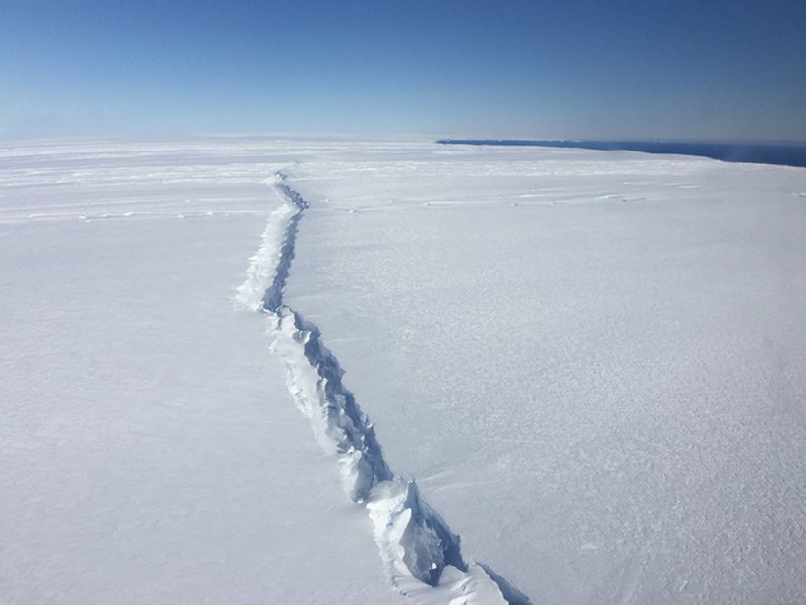
Multi-fidelity experimental design for ice-sheet models
Pierre Thodoroff

Slide 2
AGENDA
Ice-sheet models
Theoretical insights
Future directions/projects
Multi-fidelity experimental design
Applications to PDE and ice-sheet

Slide 3
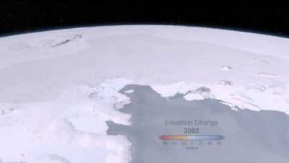
WHAT ARE Ice-sheet models?
Notes:
This is the sea we are working on.

Slide 4
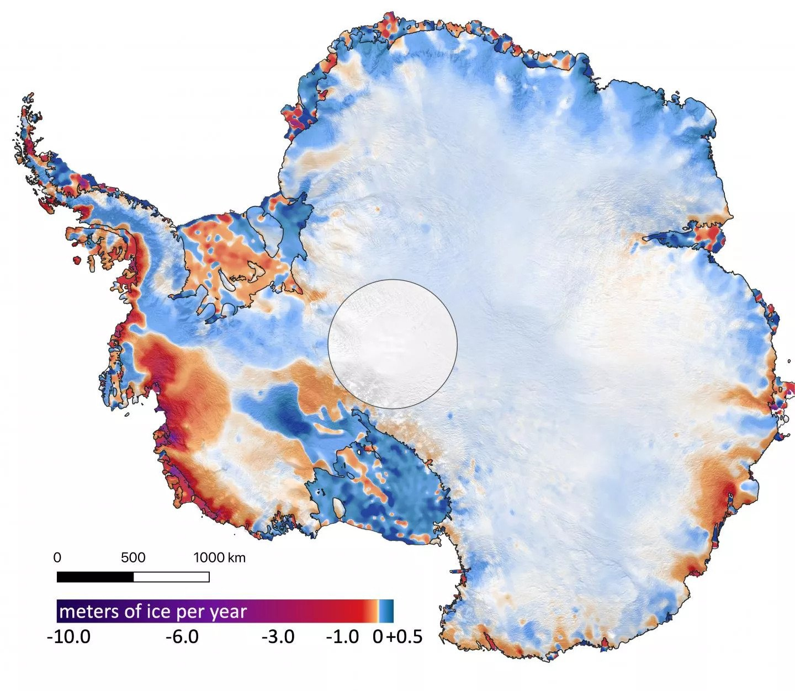
WHY ARE THEY USEFUL?
Predicting the melting of the ice-sheet and the contribution to the sea level.
Ice-sheet are not stationary ice cubes. They move, deform and melt through time.
Interesting facts:
If all the ice melt -> 60 meters increase in sea level.
Thickness of the ice at the deepest point is approximately 15 Eiffel tower!
4

Slide 5
Modelling ice-sheet movement
Goal: predict the velocities at any spatial location in the future.
Secondary goal: predict the shape of the ice sheet.
Two components to consider:
Mass change such as the melting or accumulation of ice
Physical forces such as gravity, basal drag…
Physical model: fluid moving through time (Stokes flow)

Slide 6
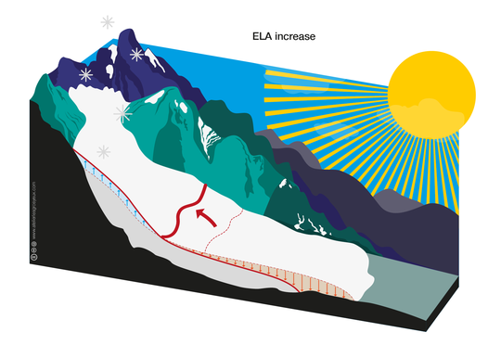
Ice-sheet 101: MASS BALANCE
Positive mass: snowfall
Negative mass: melting
Simplified model

Slide 7
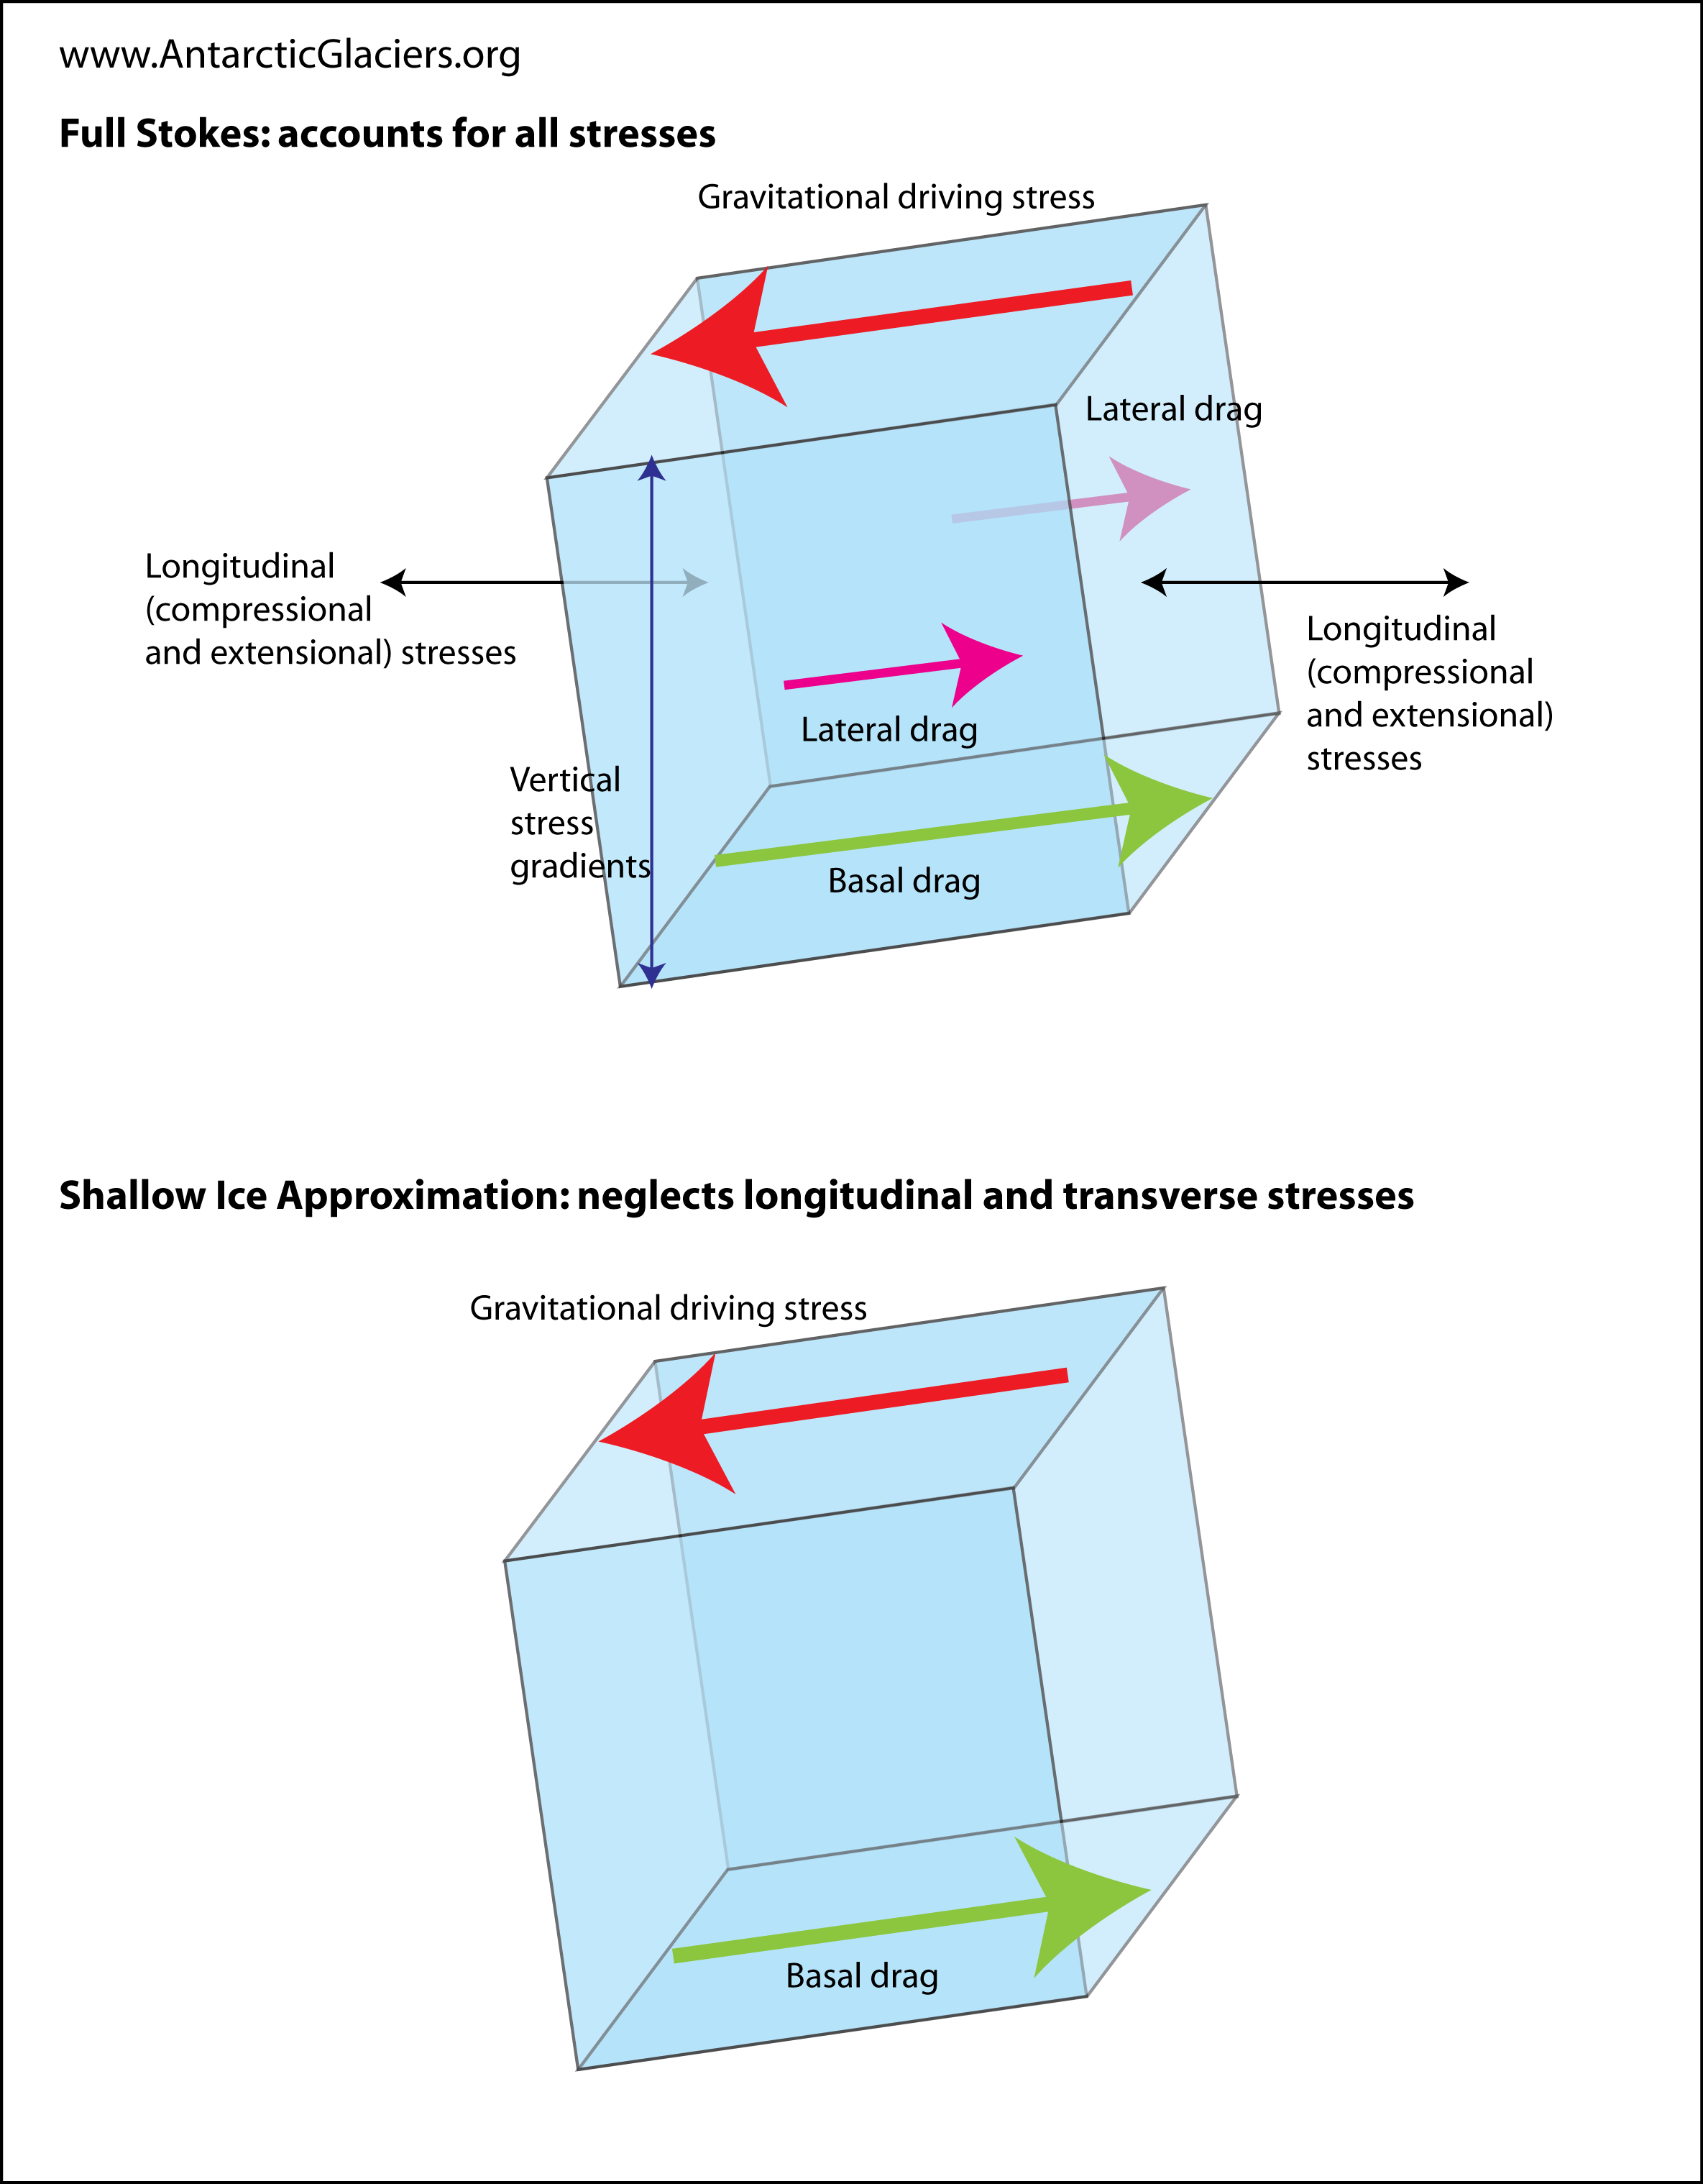
Ice-sheet 101: PHYSICAL FORCES

Slide 8
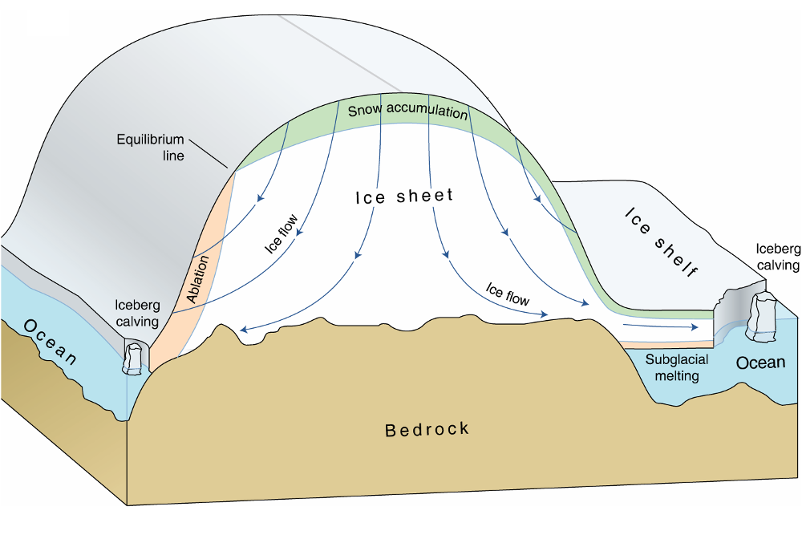
Ice-sheet 101: SUMMARY
Mass accumulation on top
Mass ablation at the bottom
Ice-flow downwards due to gravity
Model physical forces (such as basal drag, gravity…) using Stokes flow

Slide 9
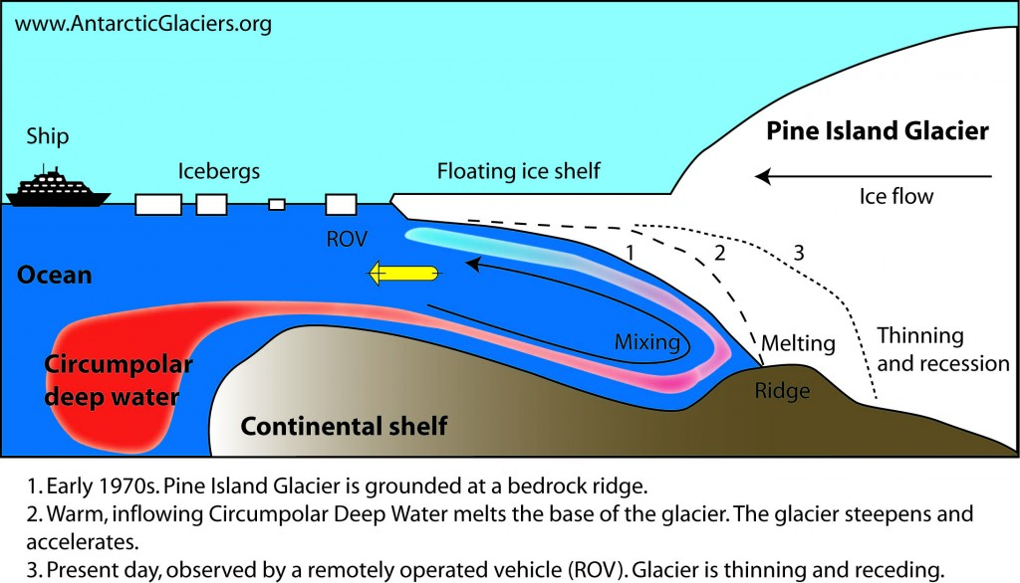
Melting of ICE

Slide 10
GoaL: predict Sea level increase
Run the ice-sheet model forward for 100 years and predict the contribution to sea level (SLC) from the melting.
Uncertainty over many parameters: bedrock, precipitation, melting rate...
Require forward runs over many input parameters.
Probabilistic estimate of the contribution to seal level.

Slide 11
Computational constraints
Unknown bed rock (basal drags), physical constraints and various forces to consider. Simulation is computationally expensive (inverse problem).
Running high-resolution models (small grids) can take several weeks.
Required to run the model over various initial states and parameters.

Slide 12
Computational optimization
Numerical solvers rely on temporal and spatial discretization to solve differential equations (no closed-form solution).
Computational costs are dependent on the resolution used.
How small should my grid be to accurately estimate the contribution to sea level?
Project: optimize the accuracy/cost ratio of running the simulator.

Slide 13
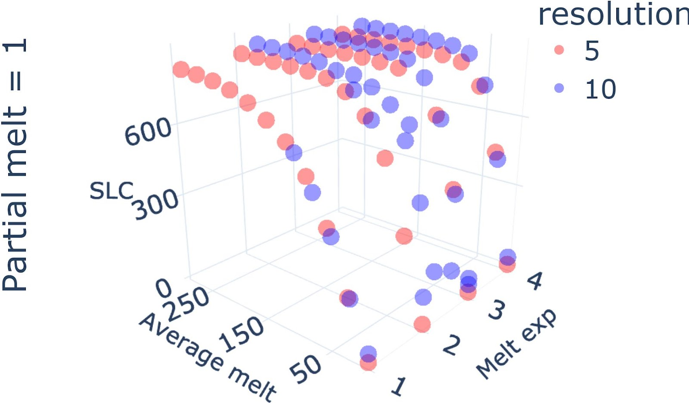
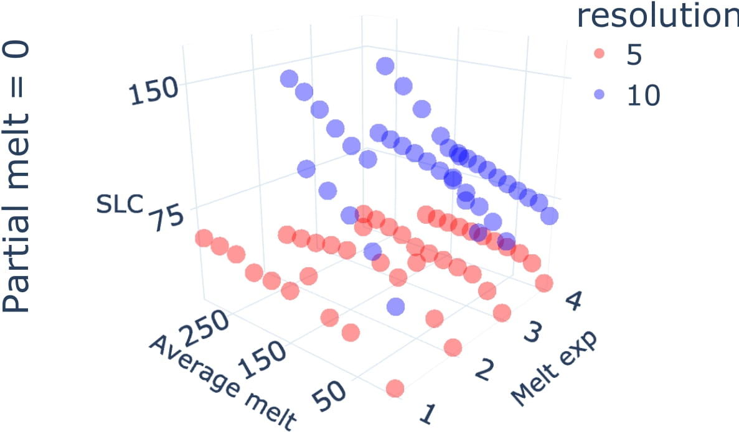
Ice-sheet data

Slide 14
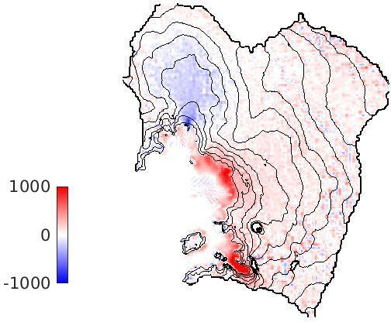
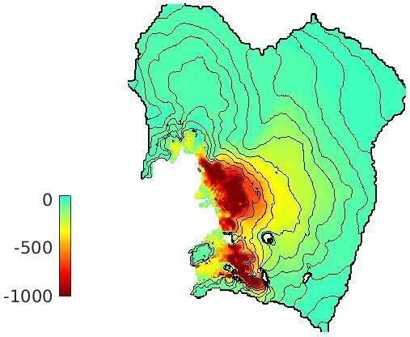
RESOLUTION DEPENDENCY
Left: modelled ice thickness change (in metres) over 100 years. Right: the difference in modelled ice thickness between a 10 km and a 3 km simulation.

Slide 15
ML agenda
Intro to multi-fidelity experimental design (MFED)
Theoretical insights
Jupyter notebook applying MFED to simple PDE
Interesting projects and extensions
Notes:
Need to add somewhere. Combination of sensitivity analysis and experimental design.
Combine lecture 4 and 5

Slide 16
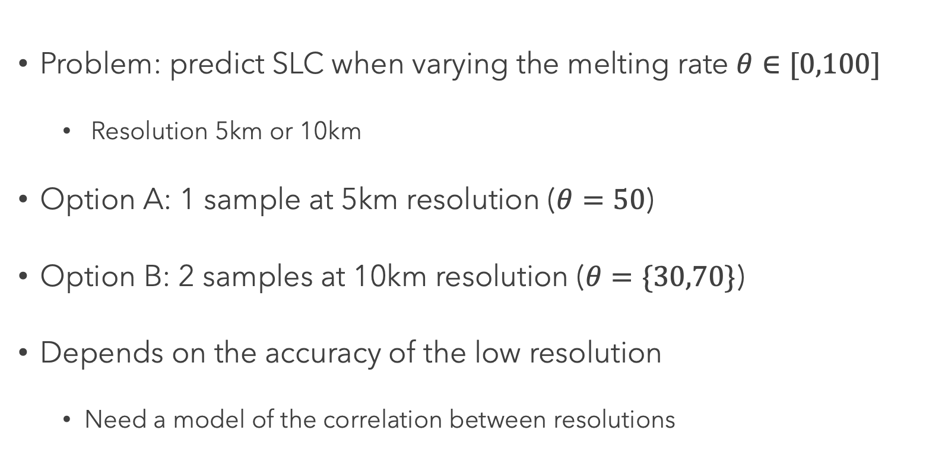
TOY EXPERIMENT
Problem: predict SLC when varying the melting rate $θ∈[0,100]$
Resolution 5km or 10km
Option A: 1 sample at 5km resolution ($θ=50$)
Option B: 2 samples at 10km resolution ($θ=\{30,70\}$)
Depends on the accuracy of the low resolution
Need a model of the correlation between resolutions

Slide 17
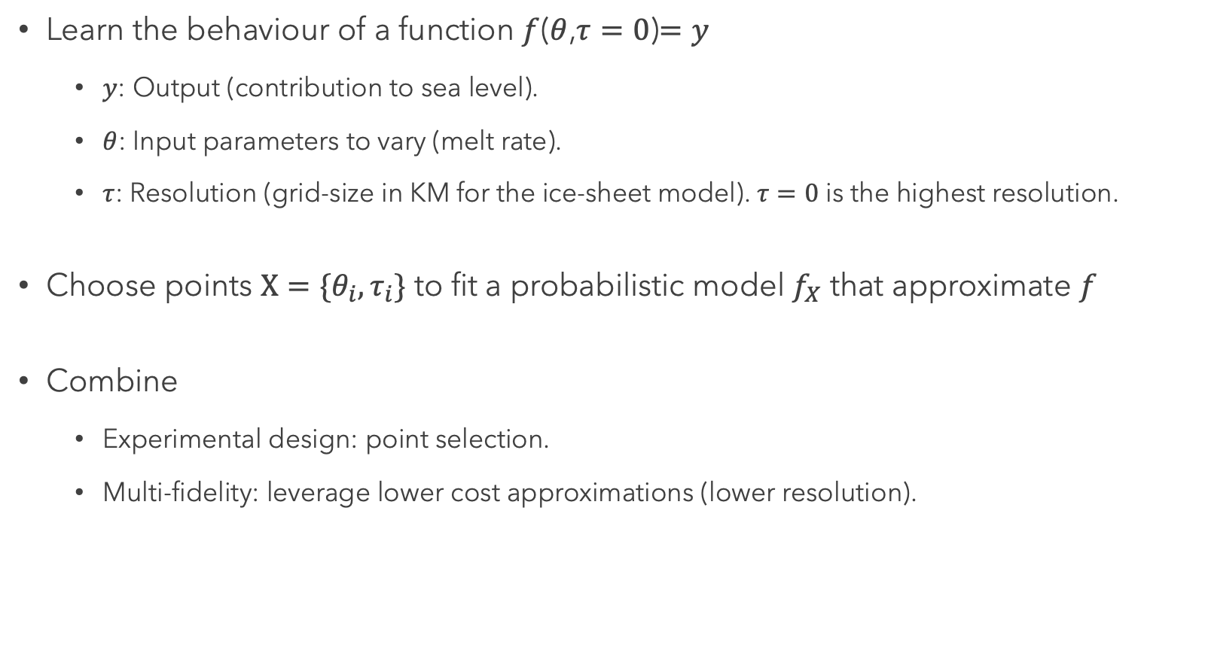
Objective
Learn the behaviour of a function $f$($θ$,$τ=0$)$=y$
$y$: Output (contribution to sea level).
$θ$: Input parameters to vary (melt rate).
$τ$: Resolution (grid-size in KM for the ice-sheet model). $τ=0$ is the highest resolution.
Choose points $X=\{θ_{i},τ_{i}\}$ to fit a probabilistic model $f_{X}$ that approximate $f$
Combine
Experimental design: point selection.
Multi-fidelity: leverage lower cost approximations (lower resolution).

Slide 18
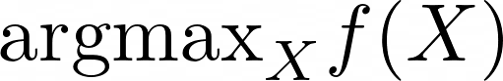
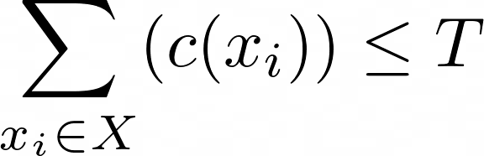
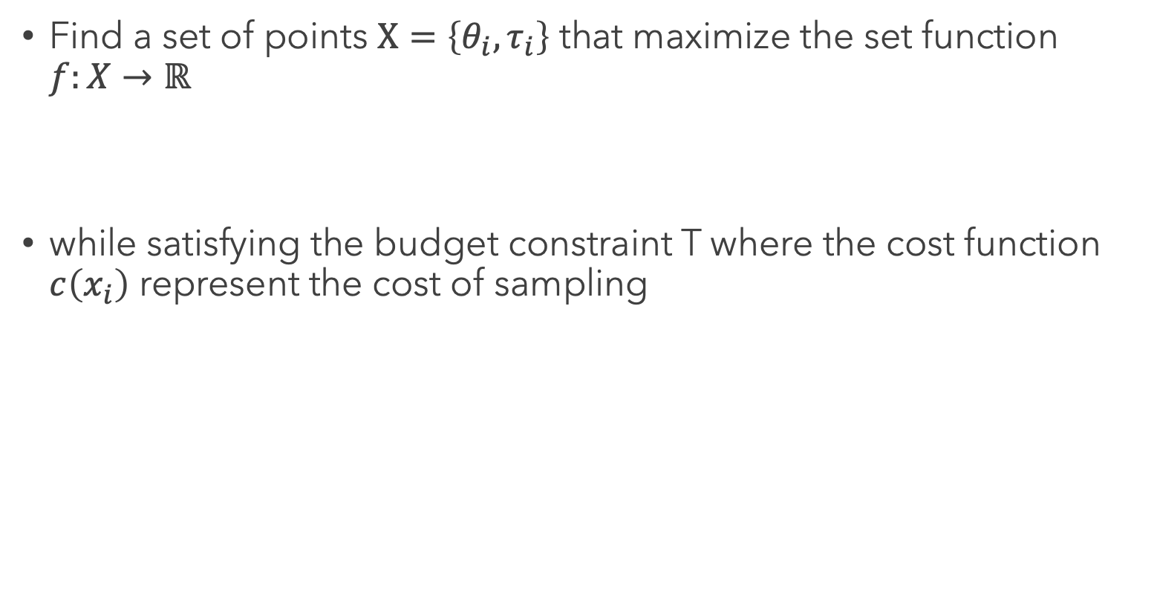
Constrained objective
Find a set of points $Χ=\left\{θ_{i},τ_{i}\right\}$ that maximize the set function $f:X→ℝ$
while satisfying the budget constraint T where the cost function $c\left(x_{i}\right)$ represent the cost of sampling

Slide 19
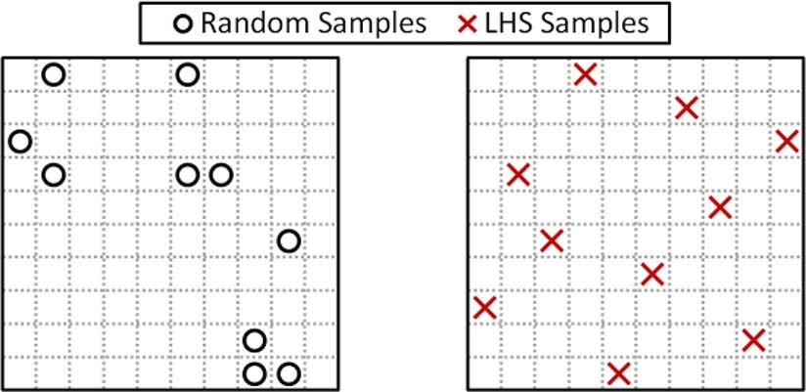
Refresher: Experimental design
Goal: choose input points to learn as much as possible about a function.
Space-filling design: choose points that maximize a distance metric between points
Latin hypercube sampling

Slide 20
Issue with space-filling design
Fail to model functions that have non-stationary behavior.
Part of the space might be more complex to model and require finer grain resolution
Hard to input user requirements
In ice-sheet we might only care about areas of the function above a certain threshold
Does not assign a value to a point which makes it complicated to adapt when comparing points of different resolutions (more on that later)

Slide 21
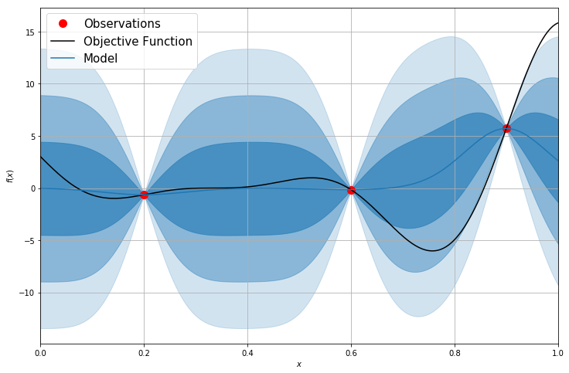
Model-based ED
Fit a probabilistic model (GP) of f on the datapoints collected.
Select points to minimize the uncertainty of the GP
Integrated variance reduction
See lecture 4 if you have any doubt.

Slide 22
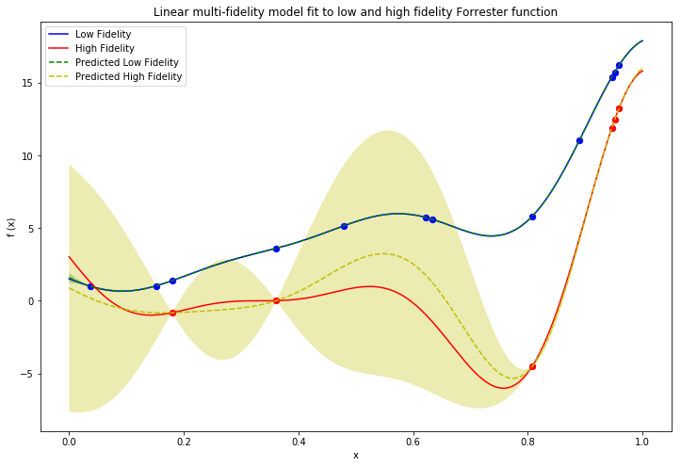
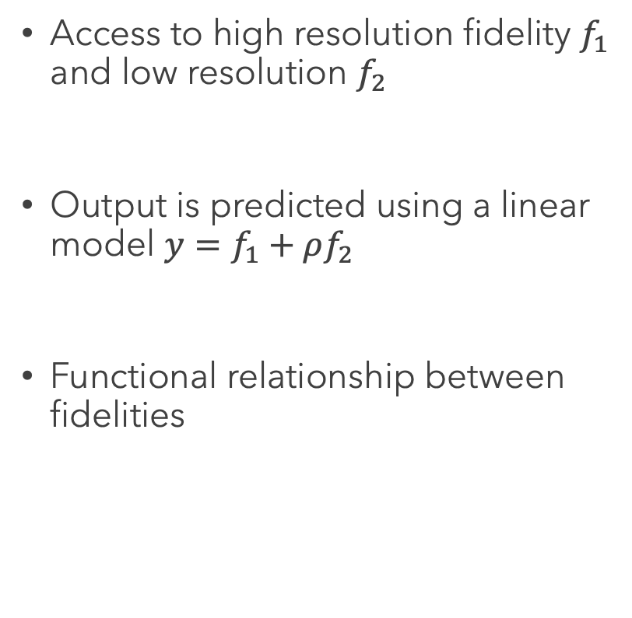
REFRESHER: Discrete Multi-fidelity
Access to high resolution fidelity $f_{1}$ and low resolution $f_{2}$
Output is predicted using a linear model $y=f_{1}+ρf_{2}$
Functional relationship between fidelities

Slide 23
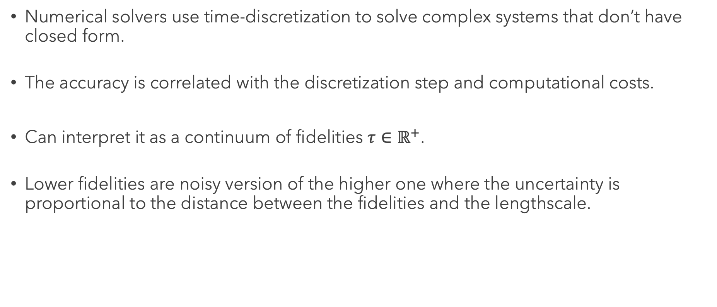
Continuous Multi-fidelity
Numerical solvers use time-discretization to solve complex systems that don’t have closed form.
The accuracy is correlated with the discretization step and computational costs.
Can interpret it as a continuum of fidelities $τ∈ℝ^{+}$.
Lower fidelities are noisy version of the higher one where the uncertainty is proportional to the distance between the fidelities and the lengthscale.

Slide 24
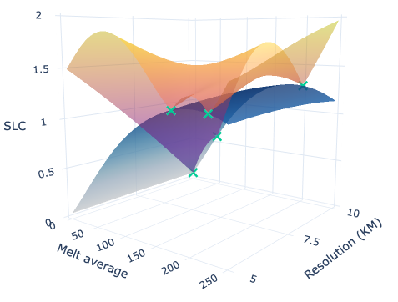
model
Model the parameter and resolution space using a Gaussian Process.
Parameters of the kernel define the strength of the correlation between resolution.
Large lengthscale mean lower resolution are informative.
Goal is reducing the uncertainty at the highest resolution.
Notes:
The tighter the lengthscale the tighter the uncertainty bar

Slide 25
Multi-fidelity experimental design
Modeling (previous slides)
How do you model the function as well as the relationship between resolutions ?
Decision-making (next slides)
What is the utility to optimize?
How do you choose the next point based on the model?
BO, RL, Online learning, bandits (all connected)…

Slide 26
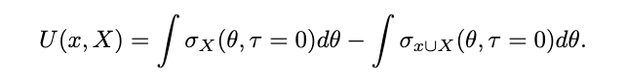
Utility: Conditional integrated variance
Integrated variance at the highest resolution possible.
Points at lower resolution are not useful on their own. With a model we can make predictions at high resolution that are useful.

Slide 27
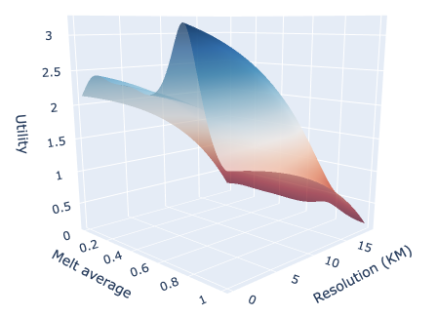
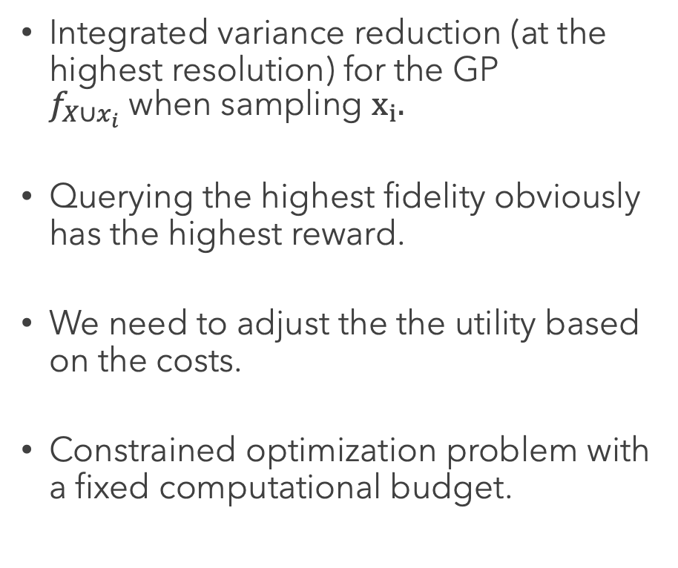
Utility: uncertainty reduction
Integrated variance reduction (at the highest resolution) for the GP $f_{X∪x_{i}}$when sampling $x_{i}.$
Querying the highest fidelity obviously has the highest reward.
We need to adjust the the utility based on the costs.
Constrained optimization problem with a fixed computational budget.

Slide 28
Planning is hard
Goal is to maximize a set function with a constraint on the total cost.
Two issues:
Combinatorial problem.
Utility of a point is not known (access to a noisy version).
We might believe low resolution points are useful at the beginning but realize they are not at the end.

Slide 29
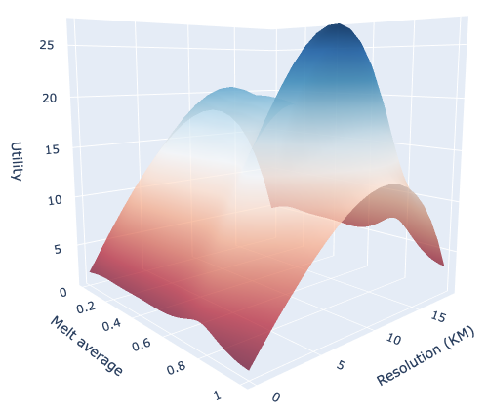
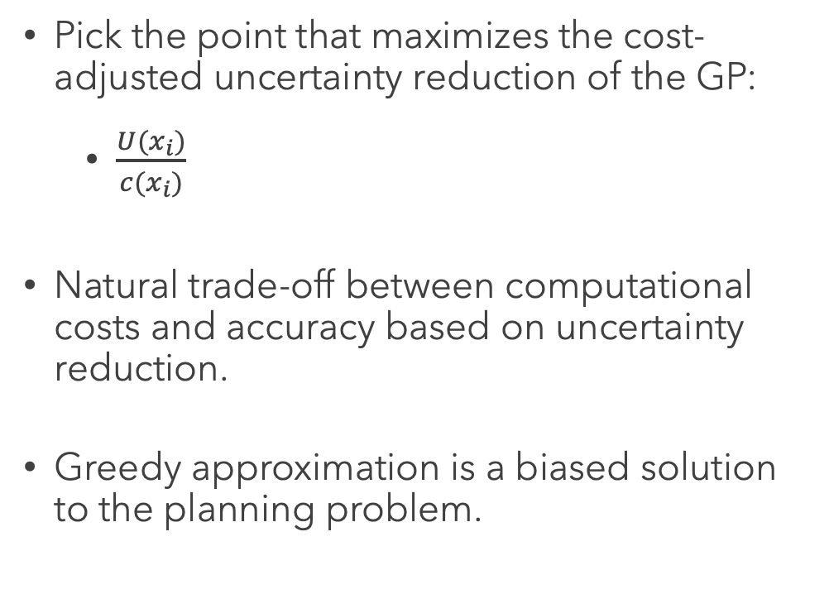
Greedy approximation: Weighted utility
Pick the point that maximizes the cost-adjusted uncertainty reduction of the GP:
$\frac{U(x_{i})}{c(x_{i})}$
Natural trade-off between computational costs and accuracy based on uncertainty reduction.
Greedy approximation is a biased solution to the planning problem.

Slide 30
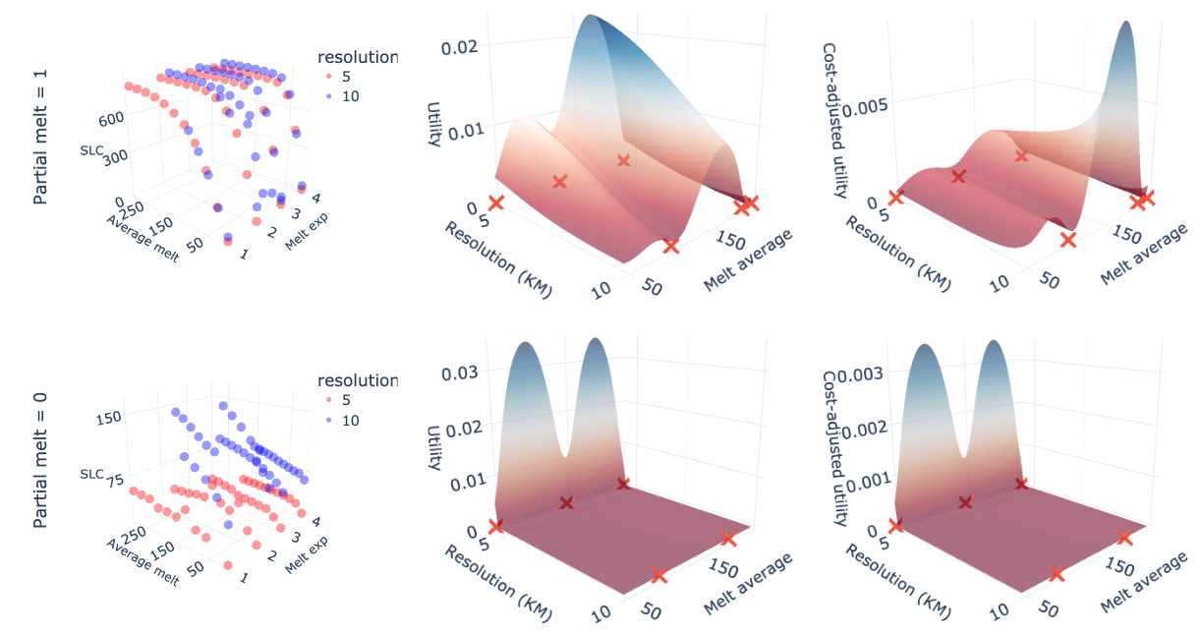
UTILITY on ice-sheet data

Slide 31
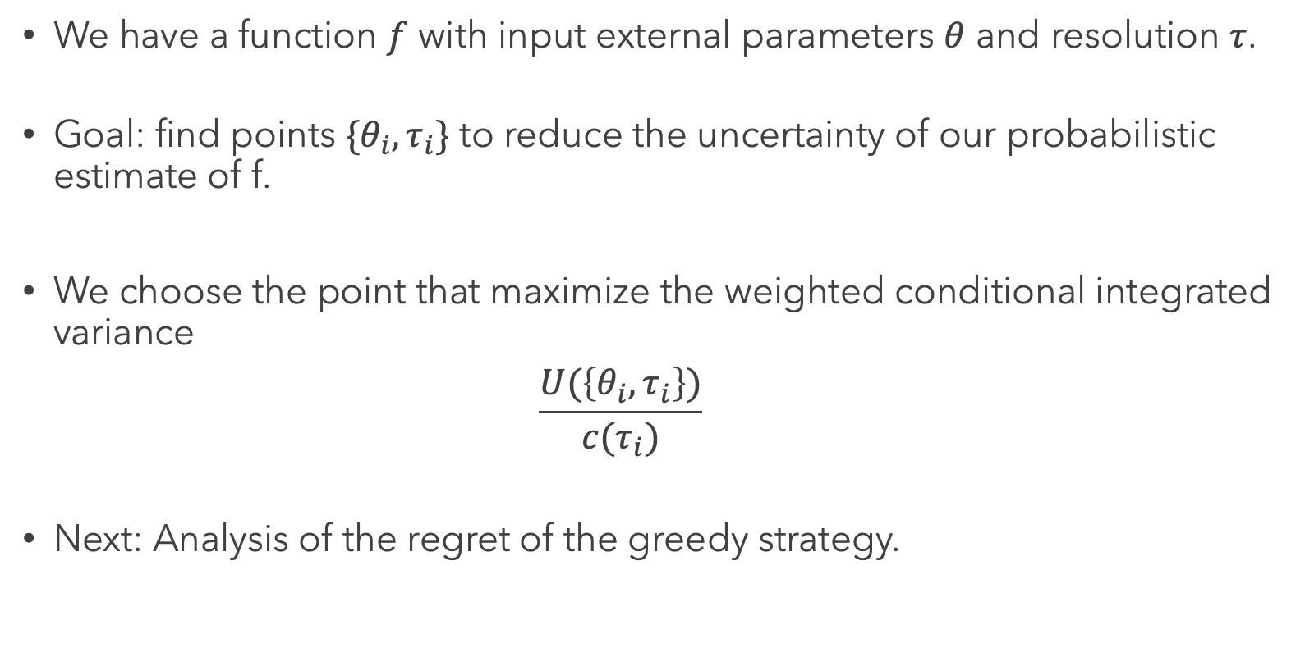
RECAP
We have a function $f$ with input external parameters $θ$ and resolution $τ$.
Goal: find points $\{θ_{i},τ_{i}\}$ to reduce the uncertainty of our probabilistic estimate of f.
We choose the point that maximize the weighted conditional integrated variance
$$\frac{U(\left\{θ_{i},τ_{i}\right\})}{c(τ_{i})}$$
Next: Analysis of the regret of the greedy strategy.

Slide 32
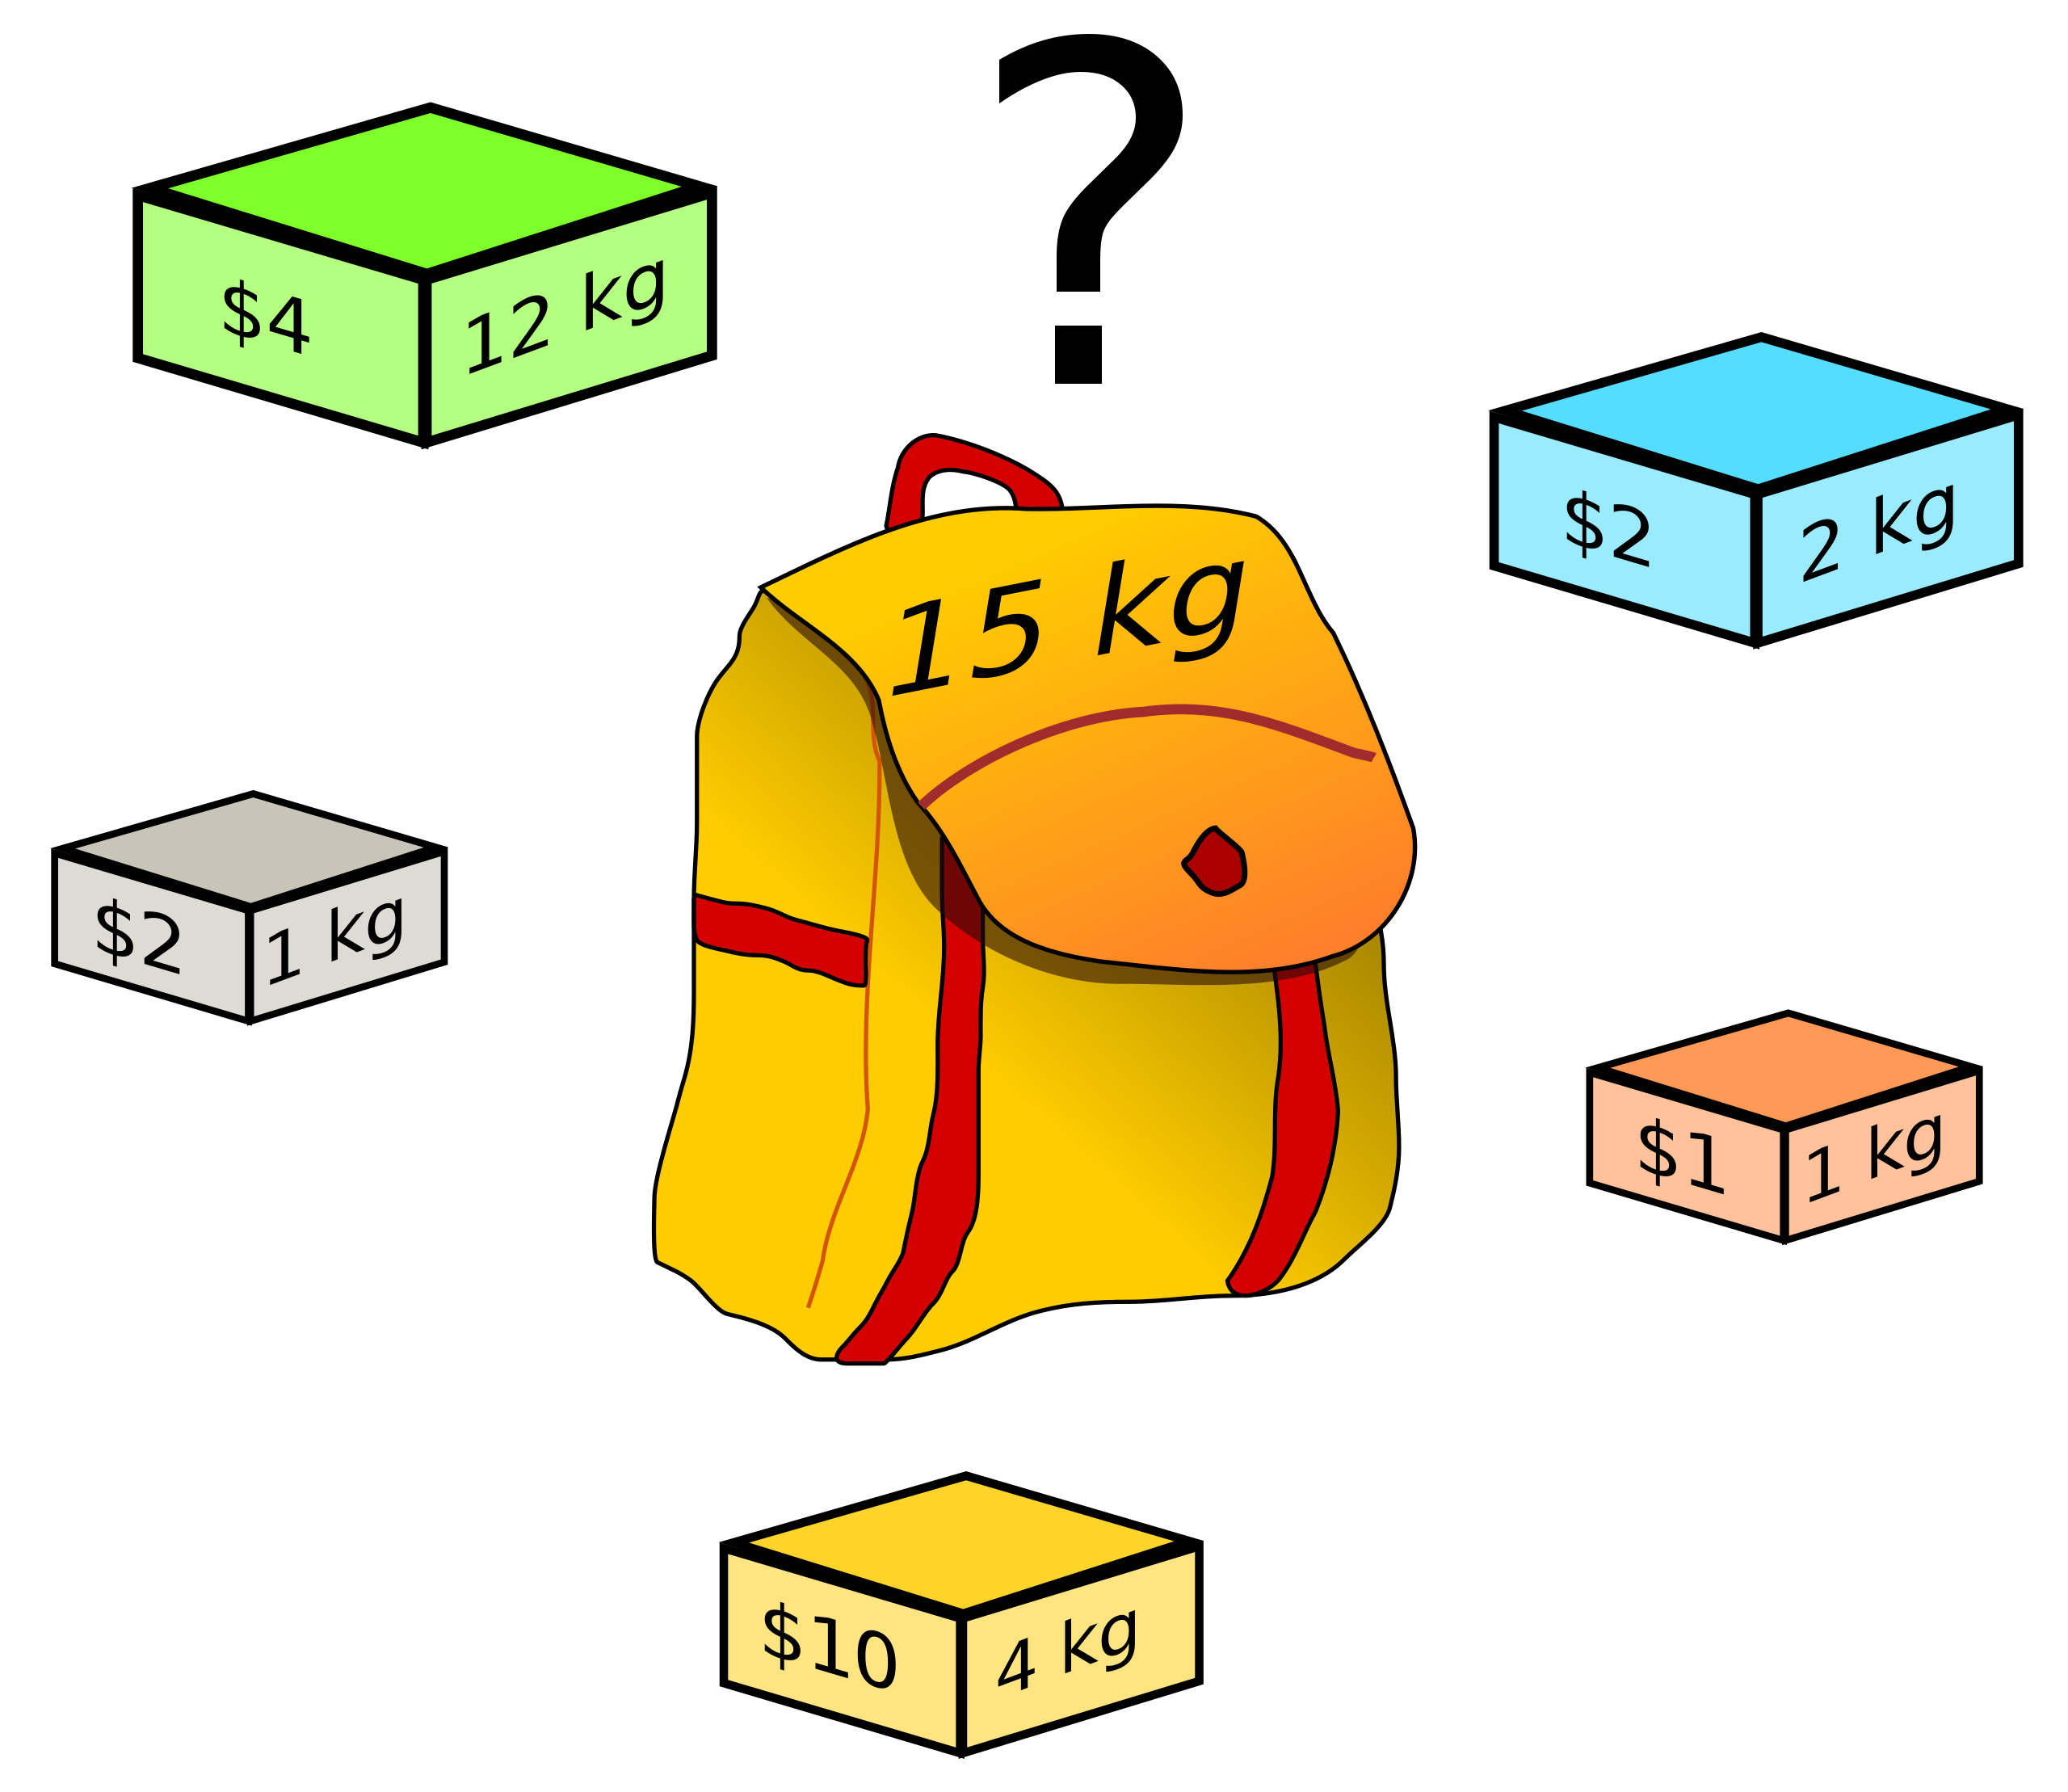
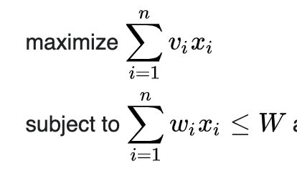
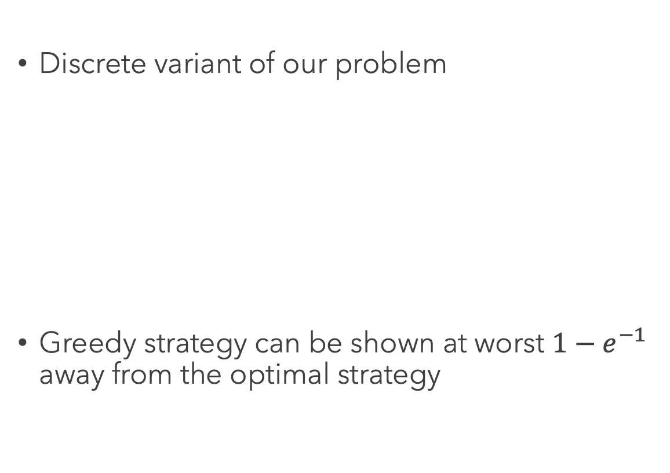
KNAPSACK PROBLEM
Discrete variant of our problem
Greedy strategy can be shown at worst $1−e^{−1}$ away from the optimal strategy

Slide 33
Set maximization & Sub-modularity
MFED is different because we are working with set function. Value of a point doesn’t exist (value of a set does).
Generalization of the knapsack result exists if the utility function satisfies the concept of sub-modularity (diminishing returns).
“you have more to gain from something new, if you have less to begin with.”

Slide 34
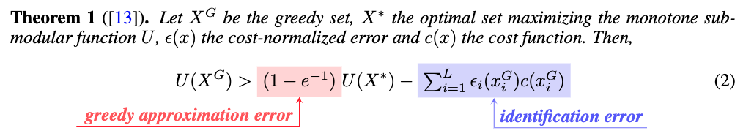
Regret of stochastic greedy strategy
Identification error exists because we don’t know the optimal resolution lengthscale beforehand and can not act perfectly greedily.

Slide 35
Experiments
Apply MFED to simple partial differential equations (notebook).
More extensive result for ice-sheet model (work in progress).

Slide 36
Potential Applications
Apply MFED to interesting physical problems that involve solving differential equations.
If you are interested in the ice-sheet simulator, a Julia version is open source. However, it can be tricky to work with so feel free to contact me.
Make any compute-related decision in ML “data-driven”
Deep learning: steps in diffusion models, floating point accuracy…
Discretization steps in normalizing flow (connection to capacity).
Notes:
Ice-sheet simulator is available in Julia but can be a bit tricky to work with. If you’re interested in working on that let me know.
” Find a problem where the decision about computation allocation is done by human and make it “data-driven”. Computational decisions are everywhere

Slide 37
Improve decision making process
Myopic behaviour due to the greedy strategy.
Leverage partial information using checkpoints to select next points.
Problem-specific modelling choices (i.e. non-stationary kernel).

Slide 38
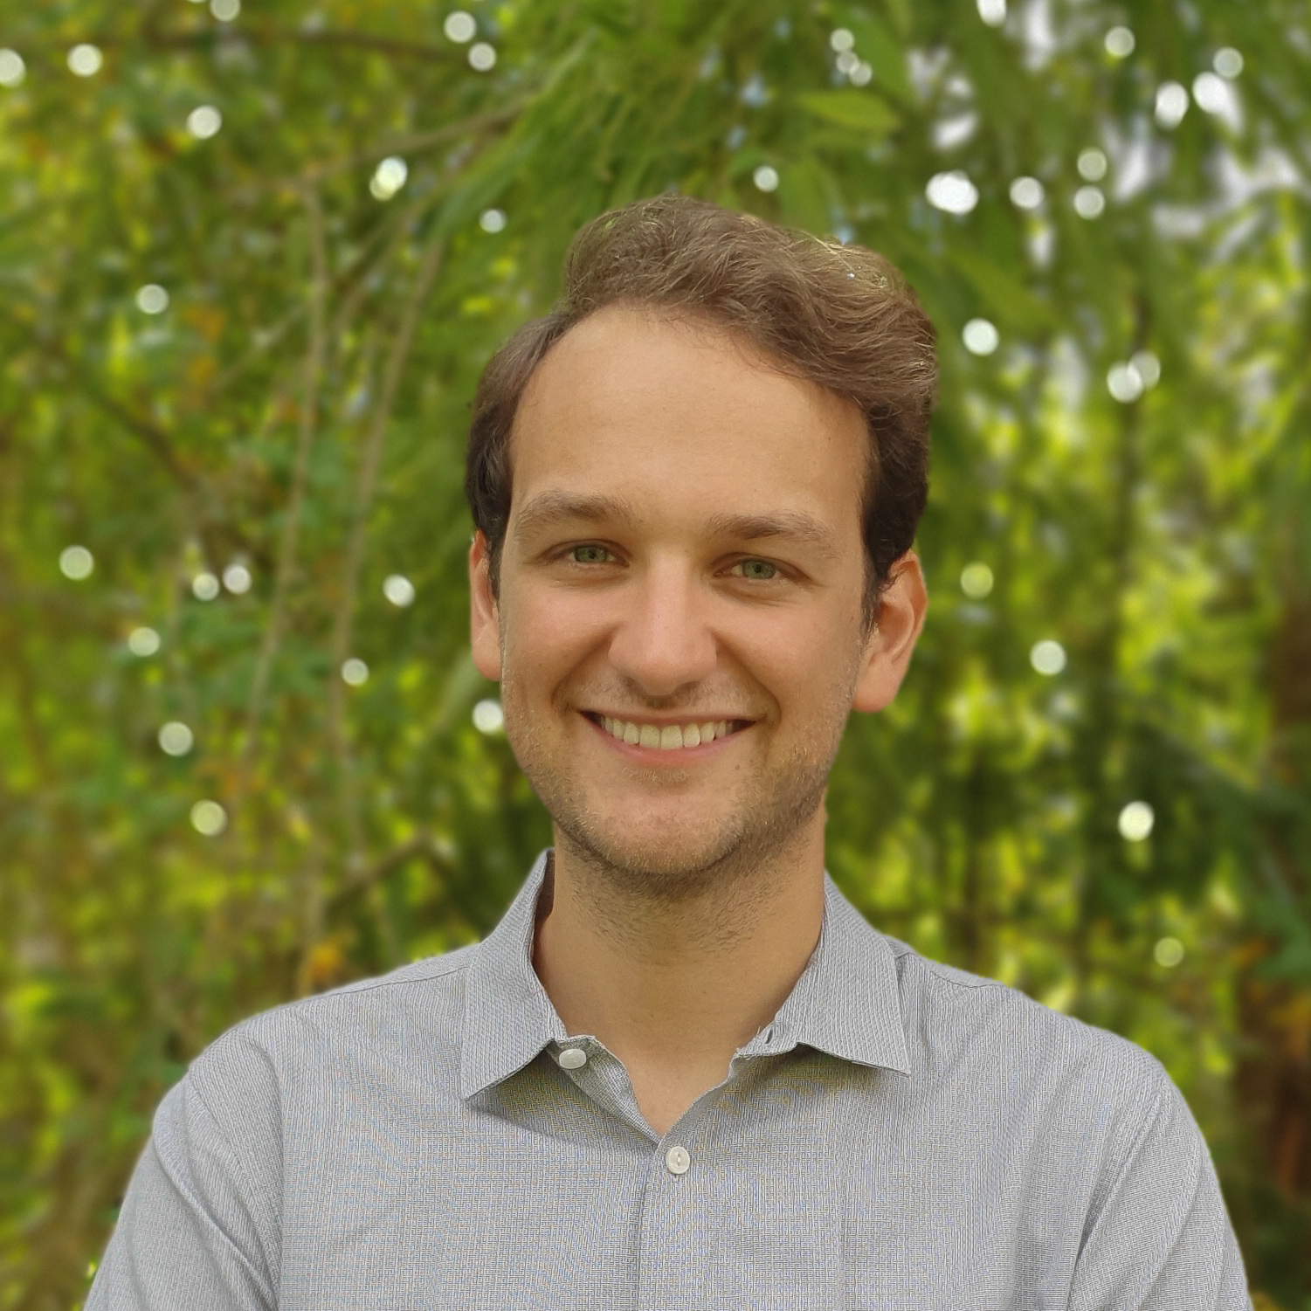
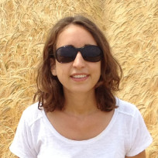
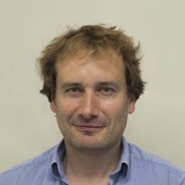



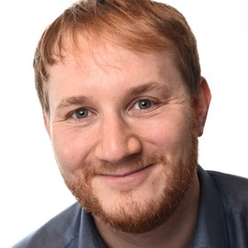
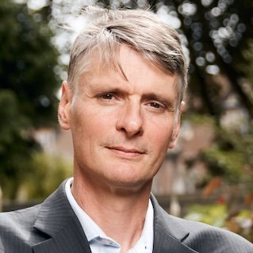
OUR TEAM
Pierre Thodoroff
Rosie Williams
Robert Arthern
Scott Hosking
Computer Lab at the University of Cambridge
British Antarctic Survey
British Antarctic Survey
British Antarctic Survey
James Byrne
Ieva Kazlauskaite
Marcus Kaiser
Neil Lawrence
British Antarctic Survey
Department of Engineering at the University of Cambridge
Computer Lab at the University of Cambridge
Computer Lab at the University of Cambridge

Slide 39
THANK YOU!
Pierre Thodoroff
pt440@cam.ac.uk

Slide 40
References
Multi-fidelity experimental design paper: https://github.com/pierthodo/multi_fidelity_experimental_design/blob/main/Multi_fidelity_experimental_design_ice.pdf
Notebook on simple PDE: https://github.com/pierthodo/multi_fidelity_experimental_design/blob/main/notebook/PDE_explore.ipynb
Glacier flow video: https://www.youtube.com/watch?v=3uoGHrIg7_Y&feature=emb_logo
Ice-sheet loss: https://www.science.org/doi/10.1126/science.aaz5845
Mass balance: https://www.antarcticglaciers.org/
Stokes graph: https://www.antarcticglaciers.org/
Motion of ice: https://wedocs.unep.org/handle/20.500.11822/7792
Experimental design sampling: https://ieeexplore.ieee.org/document/7084698
Multi-fidelity plots: https://emukit.github.io/

